Slide 1


Community-Led
Suicide Prevention:
Note for Presenters:
This is a promotional slide deck for Community-Led Suicide Prevention
It includes key talking points about the toolkit in the Notes section of each slide. Users can shorten the slide deck and speaking point as needed, but must include the funding recognition slide (slide 2)
A Web-Based Toolkit for Communities
Date
Speaker Title(s)
Notes:
I am excited to share the Community-Led Suicide Prevention web-based toolkit, which supports communities in implementing a comprehensive approach to suicide prevention.

Slide 2


Thank You to Community-Led Suicide Prevention (CLSP) Toolkit Funders!
Note for Presenter: Please be sure to include this slide!
The CLSP Toolkit was made possible by Cooperative Agreement #NU17CE924917, CFDA: 93.136 from the Centers for Disease Control and Prevention (CDC) through a subcontract from the Safe States Alliance. The contents and opinions are solely the responsibility of today’s presenters and do not necessarily reflect the official views of CDC, Safe States Alliance, or EDC.
Notes:
I want to acknowledge the CLSP toolkit funders: Safe States Alliance and the Centers for Disease Control and Prevention (CDC)
The views I express are those of myself and not necessarily those of Safe States, CDC, or EDC.

Slide 3

Note for Presenter: You can pick and choose from the goals on this slide and then remove slides from the deck that are not relevant to your presentation.
Goal 1: Slides 10-15
Goal 2: Slides 5-9 & 16-31
Goal 3: Slides 32-34
Presentation Goals
Participants will learn about the 7 key elements of comprehensive, community-led suicide prevention (CLSP)
Participants will learn about the CLSP toolkit and how to access, use, and share it
Participants will learn how the CLSP toolkit can be used to promote equity in suicide prevention efforts
Notes:
Here are the goal’s for today’s presentation:
1. Participants will learn the 7 elements of comprehensive community-led suicide prevention
2. Participants will learn about the CLSP toolkit and how to access and share it
3. Participants will learn how the CLSP toolkit can be used to promote equity in suicide prevention efforts

Slide 4

CLSP Creators:
Advisory Group Members:
Ray Bailey, MS, Youth Suicide Prevention Program Manager, Utah Office of Substance
Use and Mental Health
Elaine de Mello, LCSW, Director of Suicide Prevention Services, NAMI New Hampshire
Donna Dickman, OCPS, Director of Development for Prevention Awareness Support Services
Anne L. Geissinger, MPH, RDN, North Carolina Comprehensive Suicide Prevention Program Coordinator for the Division of Public Health
Jarrod Hindman, Chief Operating Officer, Sources of Strength
Kearee Jackson, BA, Good Behavior Game Director, Tennessee Suicide Prevention Network
Brandon Johnson, MHS, MCHES, Public Health Advisor, SAMHSA, Center for Mental Health Services (CMHS), Suicide Prevention Branch
Shelby Rowe (Chickasaw), MBA, Director, Suicide Prevention Resource Center, University of Oklahoma Health Sciences Center
Caroline Snyder, MPH, Director of Injury and Violence Prevention, National Association of County & City Health Officials
Shelli Stephens-Stidham, MPA, Senior Program Consultant, Safe States Alliance
Justin Thomas, LPC, Program Manager, Linn County Alcohol and Drug Program
Wykisha Thomas-Mckinney, MNM, Senior Project Lead, Zero Suicide Institute, EDC
EDC Staff:
Julie Ebin, Project Director
Laurie Rosenblum, Writer
Shawna Hite-Jones, Subject Matter Expert
Digital Design and Development Teams
Notes:
A small team of EDC staff worked with a national advisory group of community suicide prevention representatives, and state and national folks who work with them, to develop the CLSP toolkit. This took place December 2021-September 2022.

Slide 5
OVERVIEW
Community-Led Suicide Prevention (CLSP) Project
Notes:
How was the CLSP Toolkit Born?

Slide 6
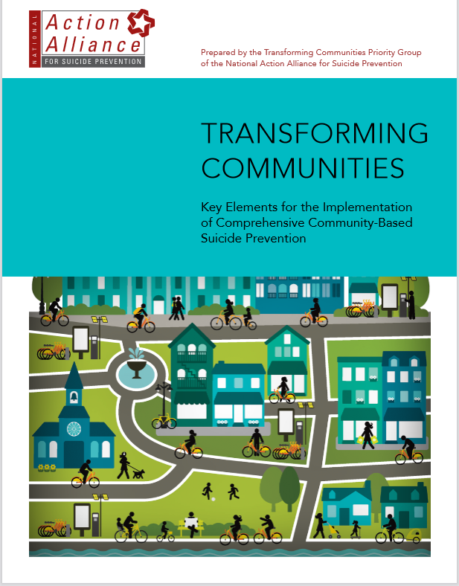
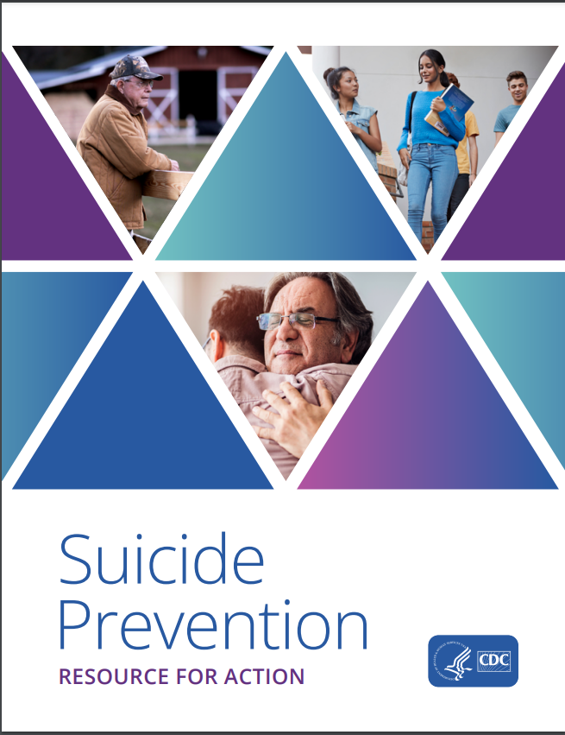
Inspiration Behind the Community-Led Suicide Prevention Project
Notes:
The CLSP web-based toolkit was inspired by both the National Action Alliance for Suicide Prevention’s report, Transforming Communities: Key Elements for Implementation of Comprehensive Community-Based Suicide Prevention, and the Center for Disease Control (CDC’s) guide, Suicide Prevention Resource for Action.

Slide 7
Inspiration Behind the Community-Led Suicide Prevention Project
Transforming Communities provides 7 key elements that guide the development of comprehensive community-based suicide prevention.
go.edc.org/AA-TransformingCommunities
Notes:
The National Action Alliance for Suicide Prevention’s report, Transforming Communities, was the first report of its kind to lay out key activities that communities should engage in to strengthen comprehensive, local suicide prevention efforts. It was developed by an advisory board of experts at the national, state, and local level.

Slide 8
Inspiration Behind the Community-Led Suicide Prevention Project
CDC’s Suicide
Prevention Resource
for Action provides strategies with evidence
of effectiveness in preventing suicide
or addressing risk
and protective factors
for suicide.
cdc.gov/suicide/resources/prevention.html
Notes:
CDC’s Suicide Prevention Resource for Action presents a select group of strategies based on the best available evidence to help communities and states sharpen their focus on prevention activities with the greatest potential to prevent suicide.

Slide 9
CLSP Helps Advance the Transforming Communities Report and CDC’s Suicide Prevention Resource for Action
Recommendations
Real-World Practice
CLSP web-based toolkit is designed to help move from high-level recommendations to specific “how to” information and resources
that support real-world practice.
Notes:
The Transforming Communities report and the CDC Suicide Prevention Resource for Action have great high-level principles and approaches. But our field has largely been missing concrete guidance on how to go about actually achieving each of the 7 key elements of Transforming Communities or choosing, implementing, and evaluating strategies from the CDC Resource for Action.
Our toolkit has been designed to help us move from high-level recommendations to specific “how to” information and supporting resources that can support real-world application of the elements and strategies.

Slide 10
OVERVIEW
CLSP 7 Key Elements
Notes:
What are the Community-Led Suicide Prevention seven elements?

Slide 11
7 Key Elements for Comprehensive
Community-Led Suicide Prevention
Unity
Planning
Integration
Sustainability
Adapted from the National Action Alliance for Suicide Prevention’s report: Transforming Communities: Key Elements for Implementation of Comprehensive Community-Based Suicide Prevention
TOOLKIT
7 ELEMENTS
Data
Fit
Communication
Notes:
The CLSP toolkit promotes Transforming Community’s 7 key elements of comprehensive, community-led suicide prevention. These 7 elements represent the key things communities need to have in place to build and sustain strong, local suicide prevention efforts.

Slide 12
Community-Led Suicide Prevention
Note for Presenter:
Slides 12‒15 can be removed if you do not want to go in-depth on the 7 key elements.
7 Key Elements for Comprehensive Community-based Suicide Prevention:
How to develop broad–based support for a shared vision
3 KEY AREAS:
Identifying leaders and partners and building their capacity
Working with community coalitions and advisory groups
Creating a shared vision
How to use data to guide action and improve efforts
3 KEY AREAS:
Accessing systems data
for planning
Gathering information
on community context
Using data to assess
progress and make changes
Unity
Data
Notes:
The first element is Unity. Unity focuses on developing broad-based support for a shared vision.
Unity includes the processes of identifying and building partner capacity specific to suicide prevention, establishing and maintaining coalitions, and creating that shared vision. It requires the formation of a network dedicated to suicide prevention.
The second element is Data. It focuses on the use of data to guide and improve suicide prevention efforts
Data includes the processes of accessing data systems that will inform a community’s understanding of suicide at the local level, gathering information on community context (aka conducting community needs assessments), and using data over the long-term to assess progress and make changes

Slide 13
Community-Led Suicide Prevention
Note for Presenter:
Slides 12‒15 can be removed if you do not want to go in-depth on the 7 key elements.
7 Key Elements for Comprehensive Community-based Suicide Prevention:
How to use a strategic
planning process
3 KEY AREAS:
Laying out a strategic
planning process
Using data to choose goals
and objectives
Putting your plan into action
How to align activities with community culture and needs
3 KEY AREAS:
Assessing and developing community readiness
Involving diverse populations
Incorporating community context and culture
Planning
Fit
Notes:
The 3rd element is planning. Planning focuses on developing a local suicide prevention strategic planning process
Planning includes the acts of identifying what strategic planning process we are going to use, choosing goals and objectives based on local needs in suicide prevention, and putting strategic plans into action
The 4th element is fit. Fit focuses on aligning suicide prevention activities with our communities’ unique cultures and needs
Fit includes the processes of assessing and developing community readiness for engaging in different suicide prevention activities, involving diverse populations in those activities, and incorporating community context and culture into prevention efforts.

Slide 14
Community-Led Suicide Prevention
Note for Presenter:
Slides 12‒15 can be removed if you do not want to go in-depth on the 7 key elements.
7 Key Elements for Comprehensive Community-based Suicide Prevention:
CDC’s Suicide Prevention Resource for Action
Provides programs, policies, and practices with evidence of effectiveness in preventing suicide
Can guide communities in selecting evidence-informed approaches
cdc.gov/suicide/resources/prevention.html
How to use multiple, complementary approaches
2 KEY AREAS:
Combining multiple, evidence-informed approaches
Facilitating efforts with diverse settings and populations
Integration
Notes:
The 5th element is integration. Integration focuses on implementing multiple complimentary approaches to suicide prevention.
Integration includes both the process of selecting and implementing multiple, evidence-informed approaches that address different suicide prevention needs and implementing those approaches in collaboration with diverse settings and populations/with those we are trying to reach
I wanted to additionally note here that the CDC Resource for Action particularly informs the Integration element. The Resource for Action provides a list of evidence-informed programs, policies, and practices that have been shown to be effective in preventing suicide or reducing risk factors for suicide. This resource can be used in coordination with the CLSP toolkit to guide their selection of evidence-informed approaches.

Slide 15
Community-Led Suicide Prevention
Note for Presenter:
Slides 12‒15 can be removed if you do not want to go in-depth on the 7 key elements.
7 Key Elements for Comprehensive Community-based Suicide Prevention:
How to communicate clearly, safely, and consistently
3 KEY AREAS:
Communicating internally and externally
Ensuring safe suicide prevention messaging
Developing strategic communication campaigns
How to create long-lasting change
3 KEY AREAS:
Maintaining sustained
partner commitment
Developing and
maintaining funding
Implementing policy
and practice change
Communication
Sustainability
Notes:
The 6th element is Communication. Communication focuses on helping us to communicate our suicide prevention message clearly, safely, and consistently.
Communication includes processes around communicating internally with partners, in addition to externally with the community, ensuring safe suicide prevention messaging guidelines are followed, and developing strategic communication campaigns.
The 7th and final element is Sustainability. Sustainability focuses on how to create long-lasting change.
This act of creating long-lasting change includes actions to help maintain partner commitment, develop funding, and implementing policy and practice change.

Slide 16
Community-Led Suicide Prevention Toolkit
Notes:
I will now provide an overview of the CLSP web-based toolkit

Slide 17

The CLSP Toolkit
Free resource for any community member seeking to advance local suicide prevention efforts
Access at communitysuicideprevention.org
Practical Information:
Resource Hub:
Examples, how-to steps, and tools
Plain language for community and lay audiences
  Can be used by communities
  and professionals who work with
  community coalitions
Provides resources that are:
  Easy to access and use
  Suicide-specific OR
  public-health specific
  Curated specifically for
  community suicide prevention
Notes:
The toolkit is designed to be a one-stop shop for community-level suicide prevention. In addition to content related to each of the key elements, the toolkit includes:
Community-based and real-world examples of communities achieving key aspects of each element
How-to steps that communities can take and tools that website visitors can download for free
Plain language that any community member, volunteer, or advocate can use to guide local suicide prevention efforts
This is also a great tool for any suicide prevention or public health professional to use in their work with communities
The toolkit includes a resource hub that provides a variety of resources specifically chosen because of their accessibility, ease of use, and focus on suicide prevention or other related public-health issues.
The 4 most useful resources related to each key element are noted within the toolkit.

Slide 18
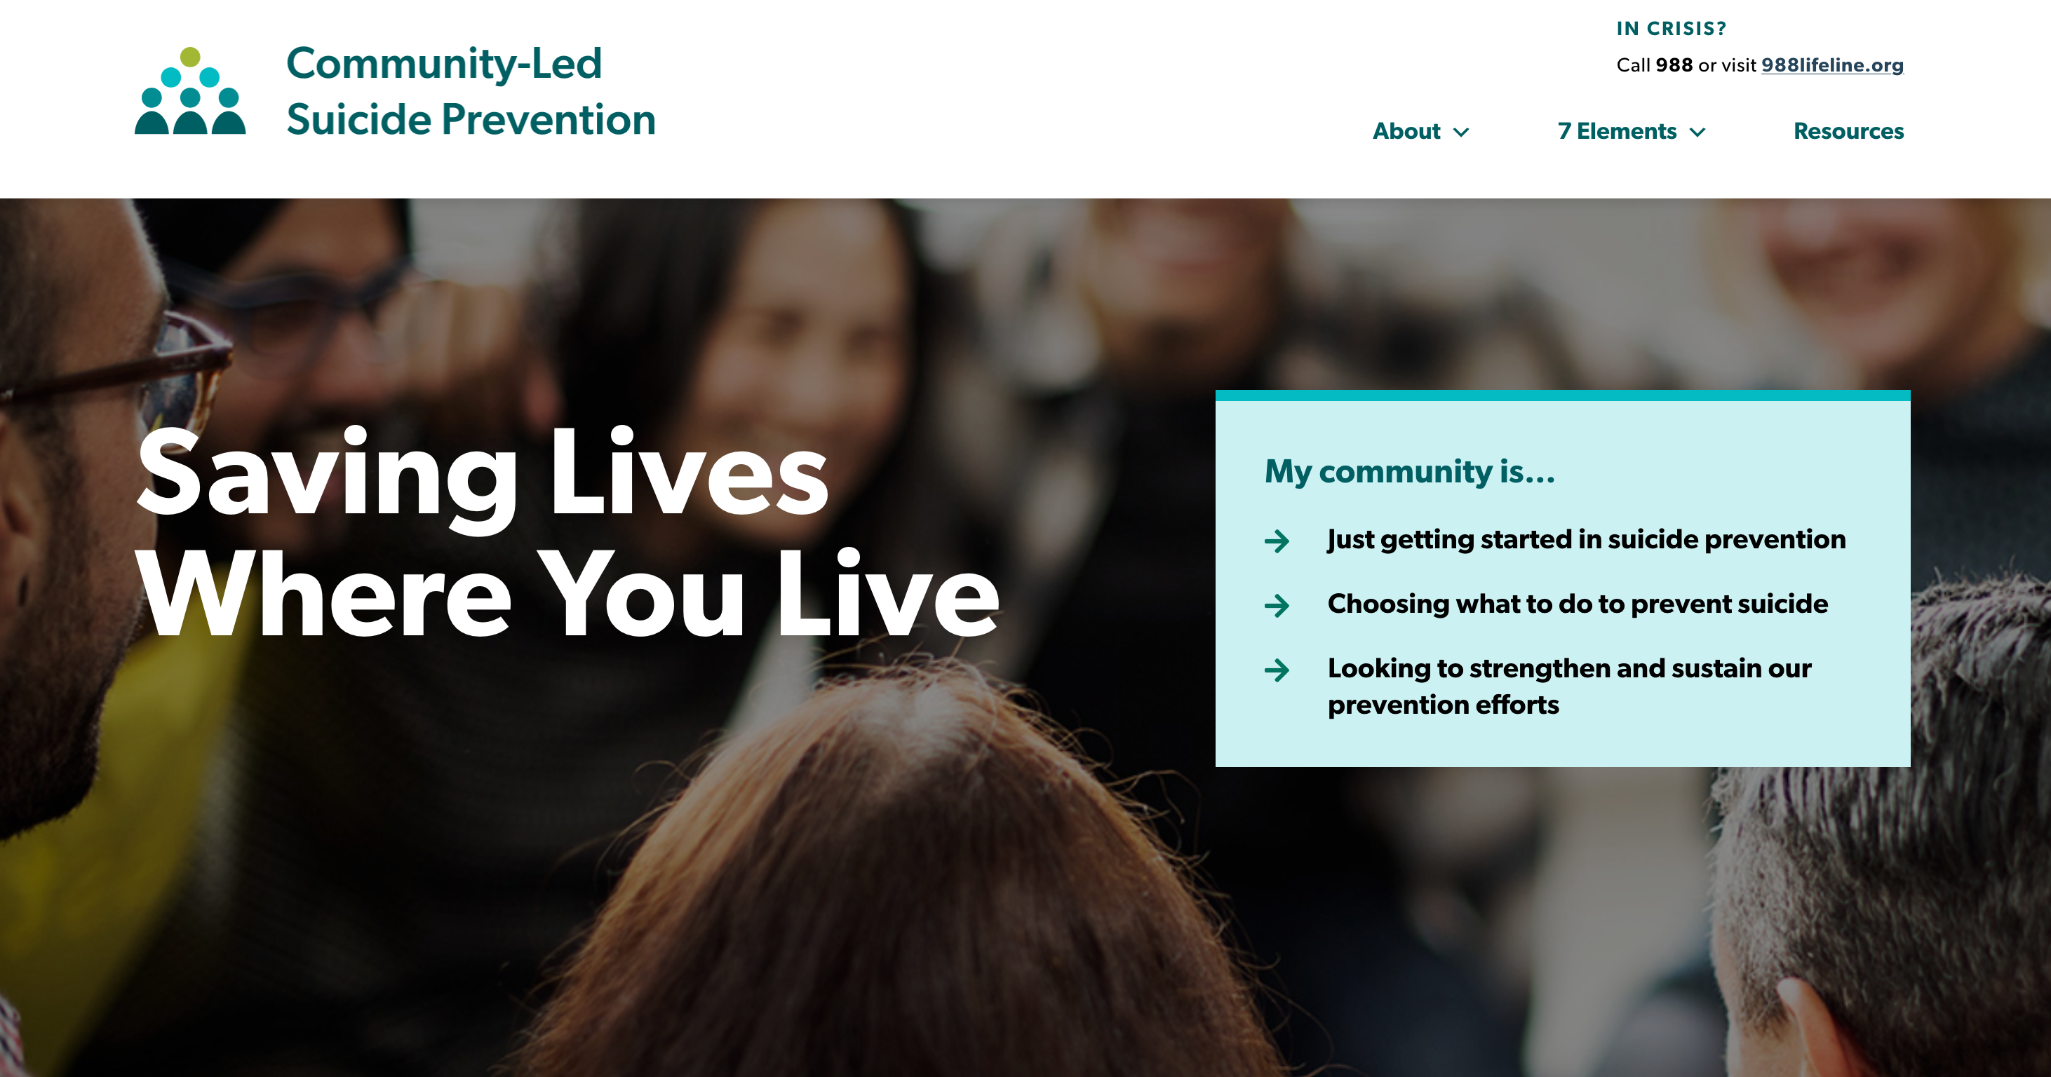
Community-Led Suicide Prevention Web-Based Toolkit
Notes:
This is a screen shot of the homepage of the toolkit.

Slide 19
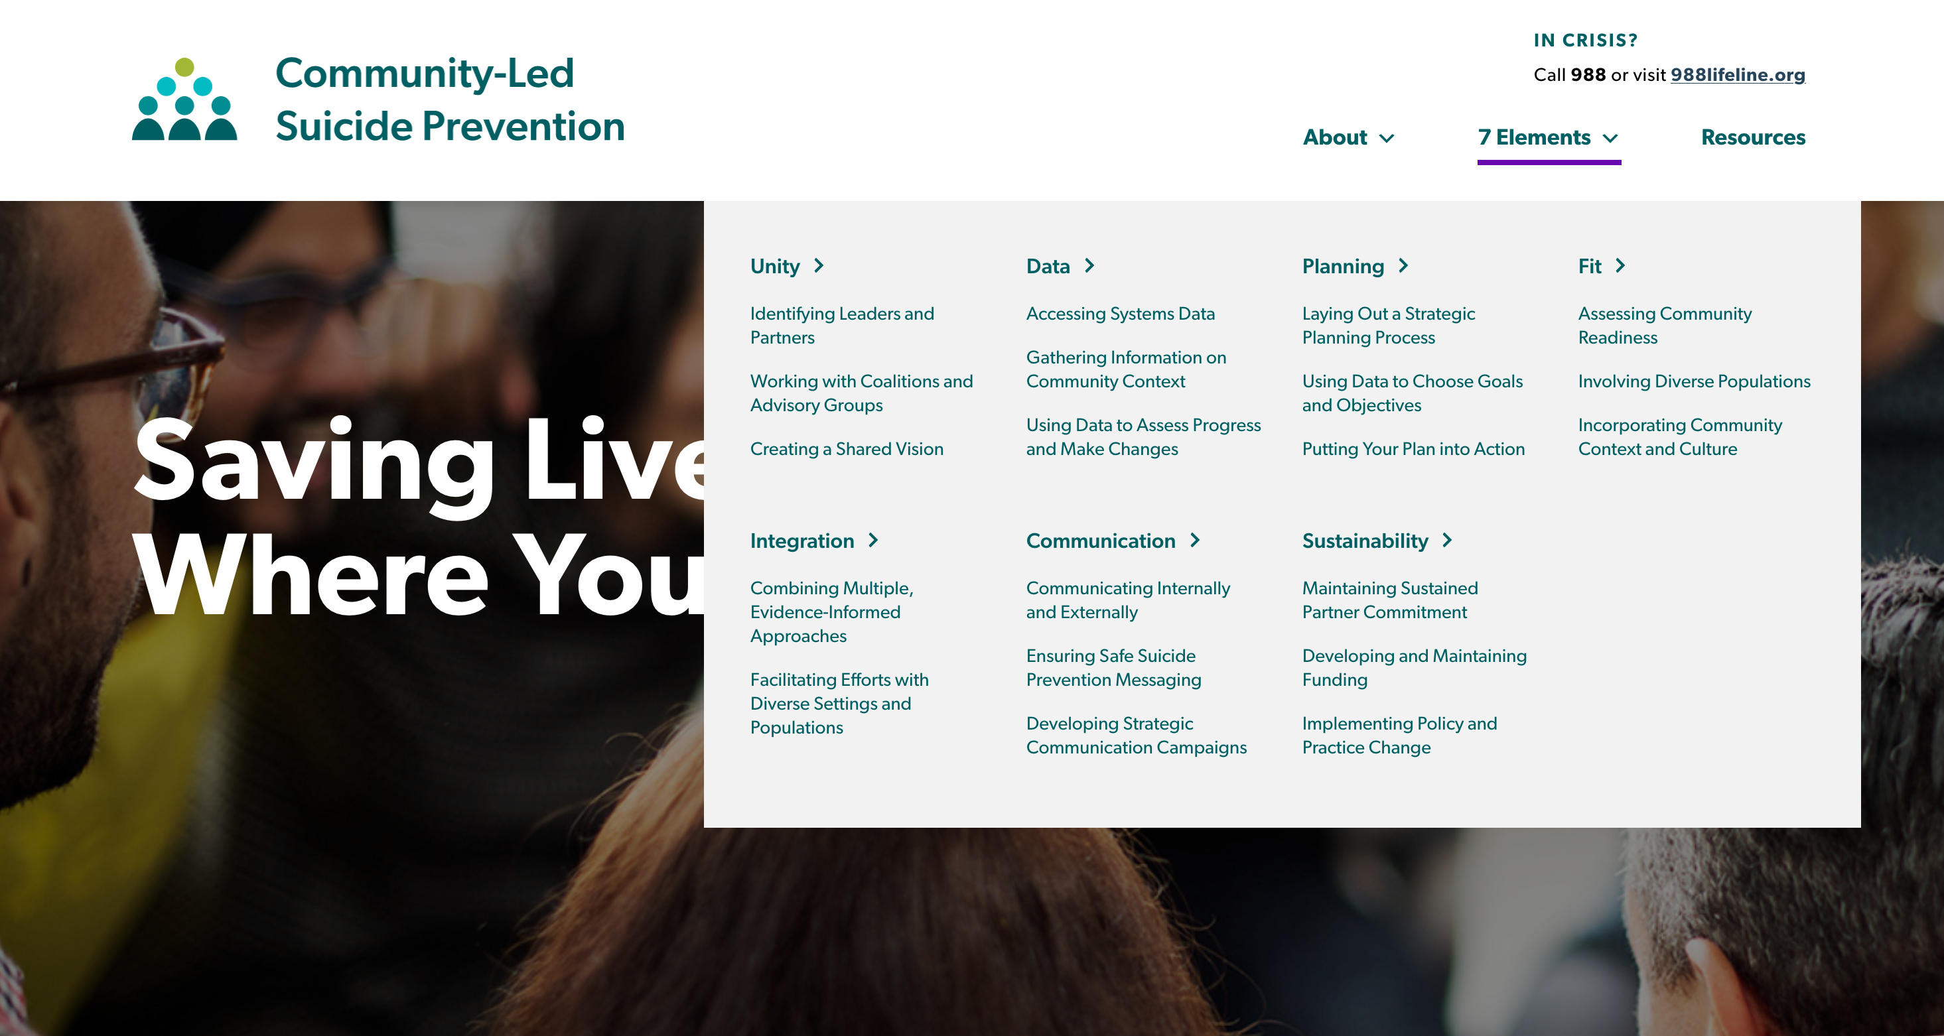
Community-Led Suicide Prevention Web-Based Toolkit
Notes:
The website’s structure is based on the 7 key elements for community-led suicide prevention.
- If you look at the main menu here under “7 Elements,” you can see that each key has its own main webpage and subpages.
- Each one of these elements has a similar structure and organization.

Slide 20
Community-Led Suicide Prevention Web-Based Toolkit
Notes:
I will have us look at the data element webpages as an example of one of the 7 elements’ sections.

Slide 21
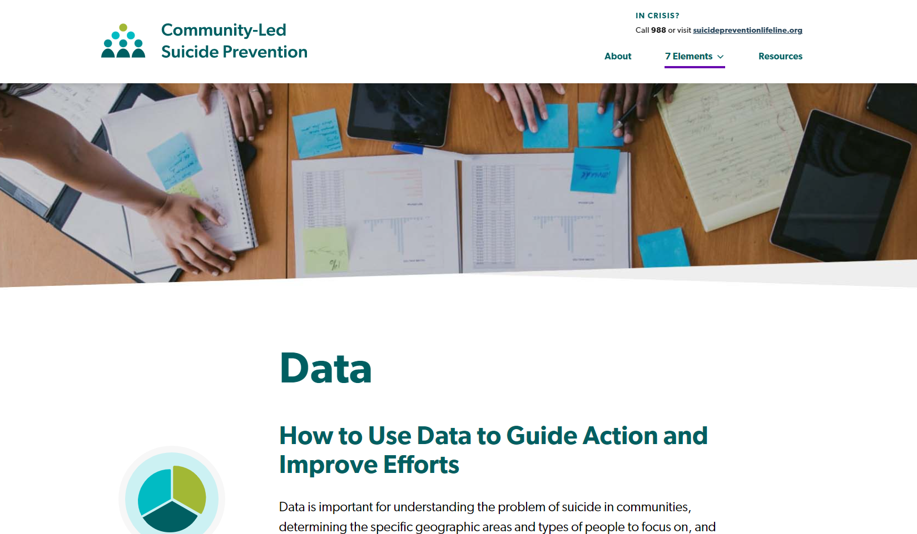
Community-Led Suicide Prevention Web-Based Toolkit
Notes:
This is a screen shot of the main data webpage/where individuals will end up if they click on the data header in the 7 elements menu.
Each element webpage will start with an overview/brief 1-2 paragraph introduction to the element

Slide 22
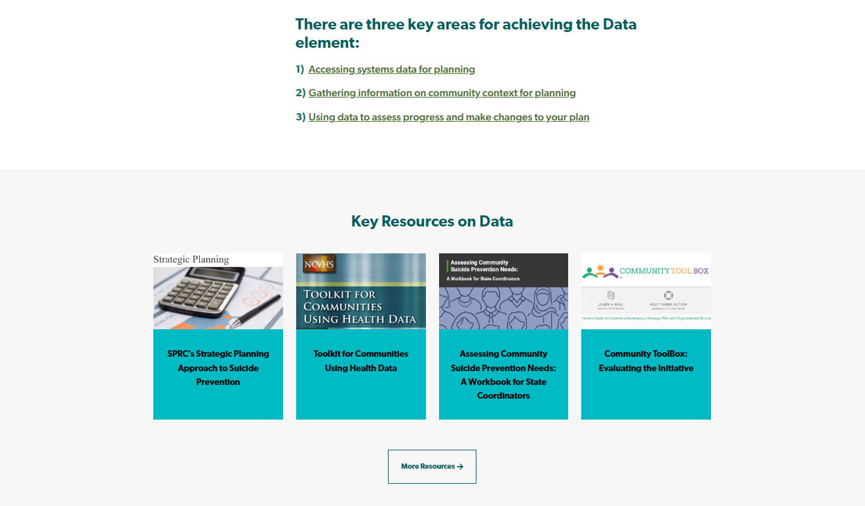
Community-Led Suicide Prevention Web-Based Toolkit
Notes:
This screen shot is of the bottom of that same data webpage. It shows two key types of information that are provided for each element:
1. Links to subpages for the key areas related to each element
2. A list of 4 key resources that are publicly available and evidence-informed. These resources listed at the bottom of each element’s webpage are ideal tools for communities to use when seeking to achieve the element.
- For those of you in public health or mental health fields, many of these tools will likely be familiar to you. We curated ideal resources for community-level staff and volunteers to take advantage of.

Slide 23
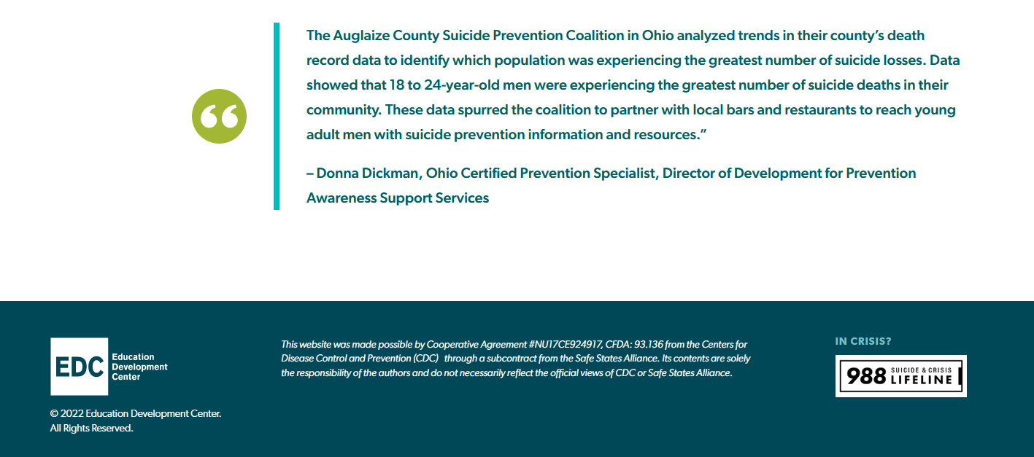
Community-Led Suicide Prevention Web-Based Toolkit
Notes:
This screen shot is of the bottom of that same data webpage and includes a real-world story highlighting the use of data in community suicide prevention.

Slide 24
Community-Led Suicide Prevention Web-Based Toolkit
Notes:
I’ll now show the structure/organization of these element subpages by showing the key area 1 subpage for Data: Accessing systems data for planning

Slide 25
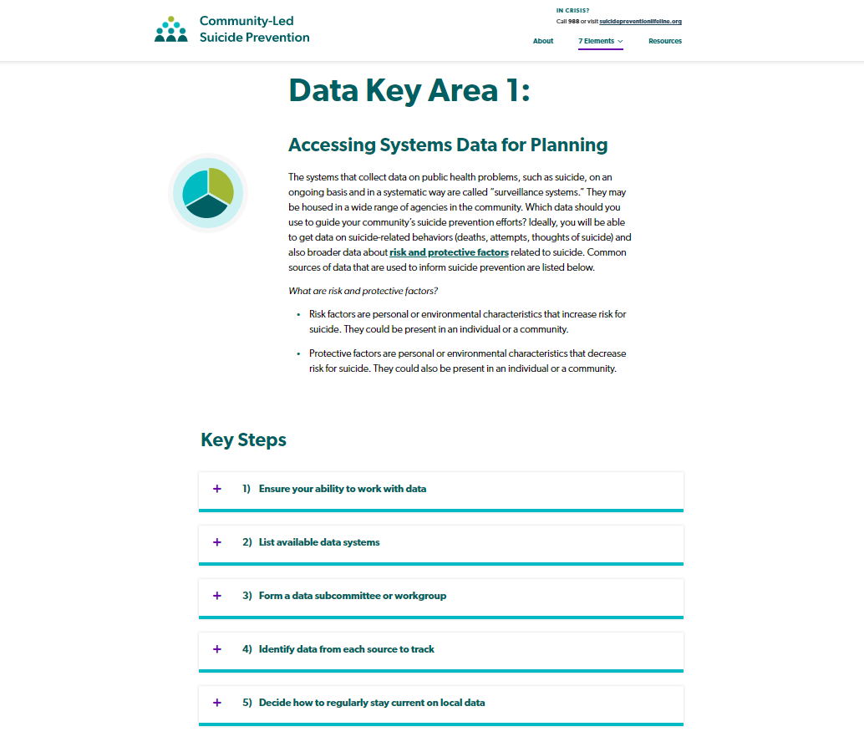
Community-Led Suicide Prevention Web-Based Toolkit
Notes:
When I go to an element’s key area subpage, there will be a brief introduction specific to that key area. You can see here that this introduction describes what systems for suicide prevention data are.
And then the webpage lists out key steps below the introduction on how to achieve that key area within the element.
In this specific example, there are 5 key steps that communities are encouraged to take to access systems data for planning.
When I click on each of these steps, an “accordion” opens with additional information on that step.
So on my next screen shot, I will show what that open accordion looks like for “Step 1: Ensure your ability to work with data.”

Slide 26
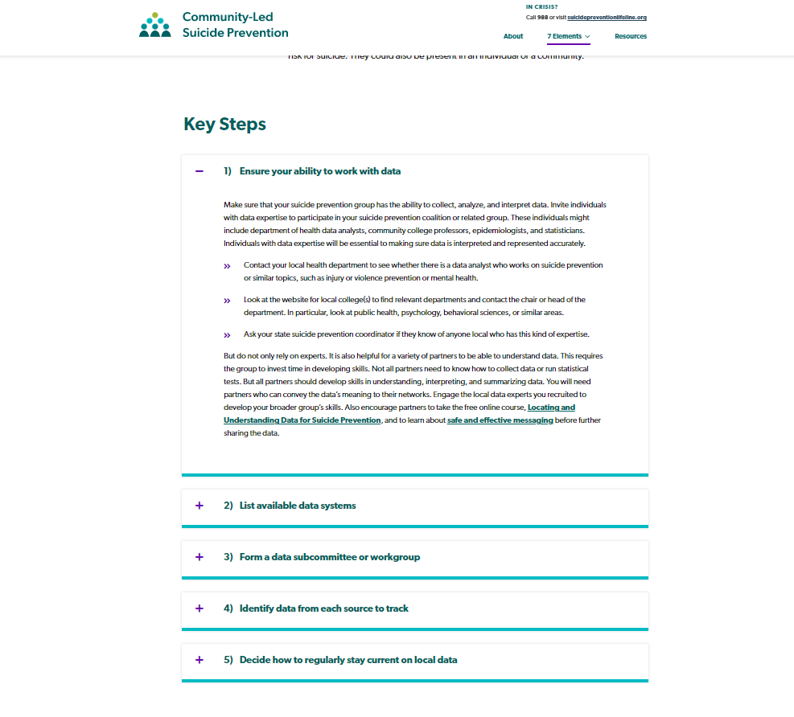
Community-Led Suicide Prevention Web-Based Toolkit
Notes:
In this expanded accordion section, you can see that there is additional information provided that includes both specific details on how to take that step (i.e., in this case what you should do as a community to ensure your ability to work with data.” And additional links to more relevant information or resources that can support communities in taking this step.
On this webpage, a community member can close the accordion by simply clicking on a minus sign that replaces the plus sign once a step is expanded. Individuals can repeat this action of opening and closing each step so that they can focus on the steps that are most important for them at a given moment in time. For example, if a community already has a list of data systems that can inform their understanding of suicide, they might not focus on step 2, but instead focus on step 3 to get more guidance on forming a data workgroup. And over time, they may return to the site to continue into the steps after that data workgroup has been formed.

Slide 27
Community-Led Suicide Prevention Web-Based Toolkit
Notes:
This screen shot is just meant to serve as a reminder that the structure/organization we just saw for the data element, is the same structure that has been used for each element and its key areas.

Slide 28
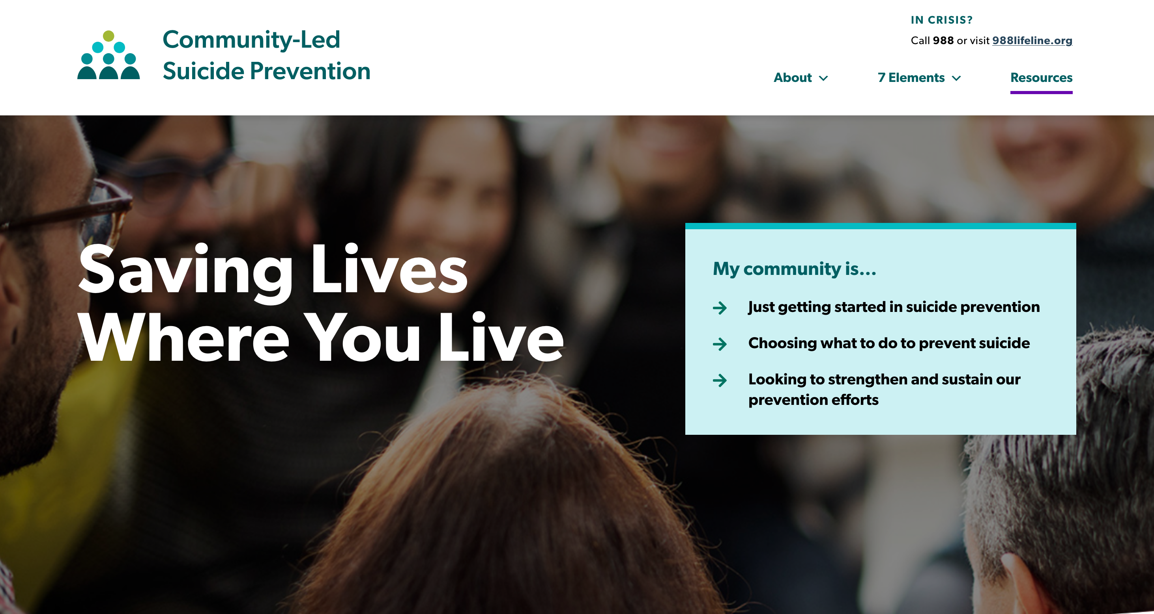
Community-Led Suicide Prevention Web-Based Toolkit
Notes:
A last portion of the site, I wanted to share is the resources hub.
- Communities will be able to access this by clicking on Resources in the top right corner of the menu.

Slide 29
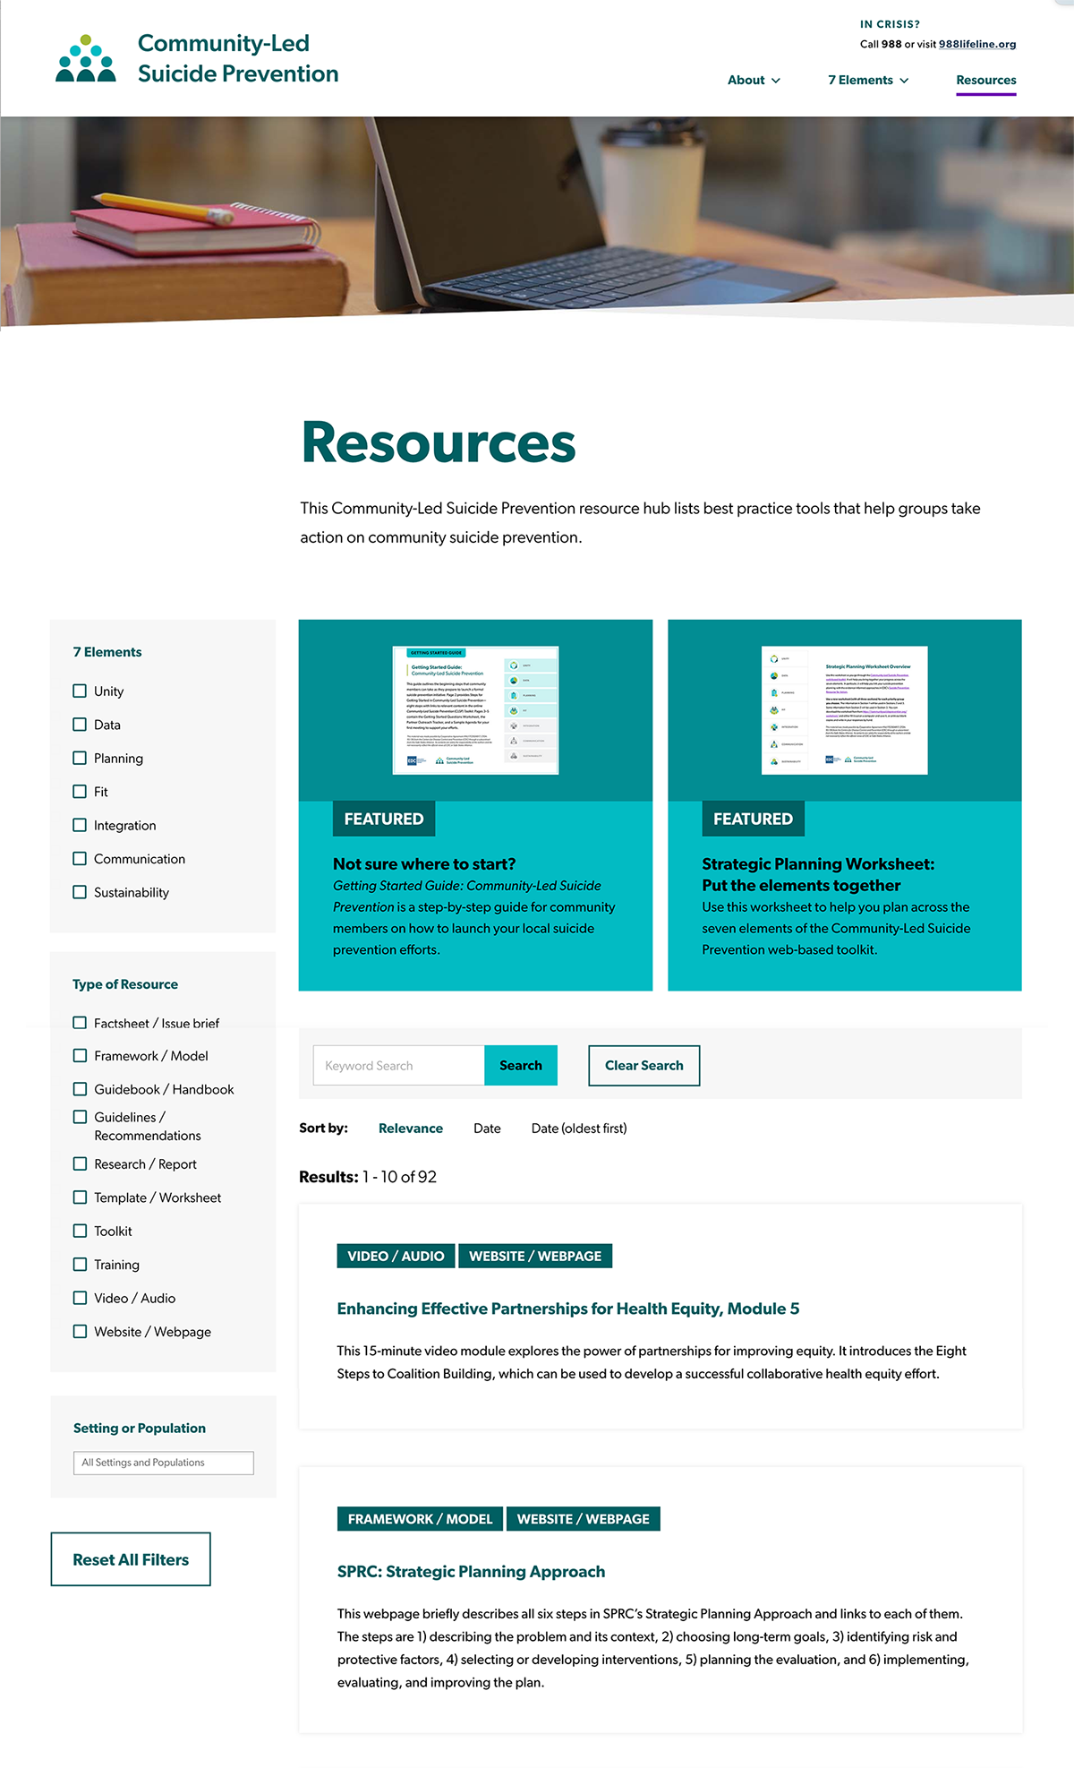

Community-Led Suicide Prevention Web-Based Toolkit
Notes:
Once on this webpage, individuals will be able to search for a variety of resources from the suicide prevention field that are specific to community suicide prevention.
Visitors will be able to search for resources according their relevance to each of the 7 elements, according to the type of resource they are, and according to what setting or population the resources are intended to reach/are focused on.
The resources included in this hub are from across a variety of organizations in both public health and suicide prevention. Resources from the CDC, SAMHSA, AFSP, SPRC, and more are all included in this hub. And we limited the resources in this hub to those that can be used to specifically inform community-level suicide prevention efforts.

Slide 30
CLSP Tools
Getting Started Guide: Guidance on the first steps to take when launching a community-led suicide prevention effort
Strategic Planning Worksheet: A tool to help communities choose and prioritize evidence-informed, suicide prevention programs, policies, and practices from CDC’s Suicide Prevention Resource for Action
Notes:
A final note on the CLSP website is that it also includes two CLSP-specific tools that are housed on the CLSP web-based toolkit.
One of these resources is a Getting Started Guide that is designed to help community members who want to lead suicide prevention efforts know where/how to get started in launching a formal suicide prevention initiative that brings together multiple partners
The second resource is a strategic planning worksheet that has been designed to help communities choose what programs, policies, and/or practices from the CDC Suicide Prevention Resource for Action they want to use to address their unique suicide prevention needs.

Slide 31
Community-Led Suicide Prevention Web-Based Toolkit
communitysuicideprevention.org
Notes:
Don’t forget that you can access this toolkit at communitysuicideprevention.org.

Slide 32
Promoting Equity
with the CLSP Toolkit
Notes:
I wanted to wrap up my presentation today by sharing a little about how the CLSP Toolkit can help you promote equity in your local suicide prevention efforts.

Slide 33

Equity in Community-Led Suicide Prevention
The CLSP Toolkit can help communities promote equity by…
Providing freely accessible and easy-to-understand steps for community suicide prevention
Calling on communities to create diverse partnerships
Developing communities’ awareness and use of state and local data, including ways to address data gaps
Encouraging communities to choose, adapt,
implement, and monitor strategies that are a good
“fit” for local context
Promoting prevention efforts that address risk and protective factors in suicide prevention
Notes:
This toolkit has been designed with the explicit intention of promoting equity in suicide prevention. There are 5 main ways the toolkit does this:
1. This is the first freely accessible website specifically designed to support communities in taking steps to prevent suicide. These steps have been written out and designed with the intention of ensuring they are in plain-language, easy to follow, and accompanied by relevant examples.
2. The steps throughout the CLSP toolkit focus on encouraging communities to form partnerships that support suicide prevention. These diverse partnerships are essential to implementing local efforts that draw on different community-members’ knowledge, experiences, and skills.
3. This toolkit asks communities to not just choose any evidence-based suicide prevention program that is out there. Instead, it walks communities through the process of considering what programs, policies, or practices are good matches with their local communities needs, culture, and context before choosing and implementing them, and adapting them as needed.
4. This CLSP toolkit intentionally provides communities with language, strategies, and ideas they can use to expand what we traditionally consider suicide prevention efforts. Often at the local level, we are stuck in single strategy approaches, such as promoting trainings on recognizing the warning signs of suicide or hosting quick, one-off walks. This toolkit will help communities to consider how activities they are already engaging in, such as efforts to promote youth social-emotional wellbeing or efforts to reduce poverty can contribute to the reduction of risk factors and increase of protective factors for suicide.
5. Finally, many communities experience significant challenges in using data to inform their efforts. While not an answer for every challenge around the use of data, this toolkit will help communities identify steps they can take to increase their understanding of local data. The toolkit can support communities in using data to better identify their most pressing needs and strengths.

Slide 34

Equity in Community-Led Suicide Prevention
You can help communities promote equity
in suicide prevention by…
Sharing the CLSP Toolkit with your networks
Using the toolkit in your local efforts
Reinforcing the key messages of CLSP:
  Facilitate diverse representation and partnerships in suicide prevention
  Increase capacity to use and improve data for suicide prevention
  Engage in strategic planning for suicide prevention
  Focus on comprehensive and sustainable suicide prevention
Notes:
So how can you play a role in promoting equity in suicide prevention?
1. Plain and simple, get this CLSP Toolkit out to your networks across your states and communities.
2. Go beyond just sending the toolkit out in an email or listserv. Consider how you might host your own learning events, webinars, or meetings with community organizations and/or coalitions to walk them through it.
3. Reinforce some of the key messages in the CLSP Toolkit: Encourage your communities to form diverse suicide prevention coalitions and/or workgroups, actively engage in strategic planning for suicide prevention, build capacity around use of data, and focus on comprehensive, long-term prevention and not just one-off initiatives.

Slide 35


Questions?
?
Notes:
What questions do you have?

Slide 36
Thank you
Contact Information
For more information from EDC about Community-Led Suicide Prevention, please contact:
communitysuicideprevention@edc.org

